Slide 1
















Facial Emotion Recognition
Presentation by Menna Ramadan

Slide 2

OVERVIEW
Objective :To develop an automated facial emotion recognition system using transfer learning with MobileNet architecture to classify human emotions from facial expressions.
Target Emotions: Happy, Angry, Fear, Neutral
Key Technologies: TensorFlow/Keras for deep learning, MobileNet for transfer learning, Python for implementation

Slide 3
DATASET ANALYSIS
Dataset Characteristics
Source: FER13 Cleaned Dataset
Image Dimensions: 48x48x3 (RGB color images)
Total Images: Processed from multiple emotion categories
Selected Classes: 4 primary emotions for focused classification

Slide 4
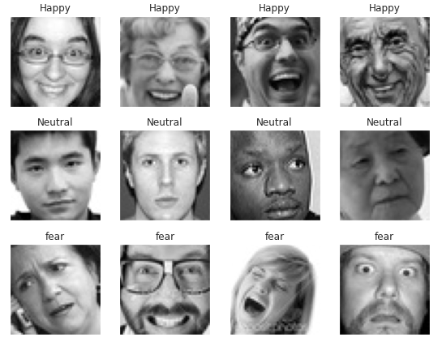

Slide 5
Data Preprocessing
Images normalized to range [0,1] by dividing by 255
Converted labels to categorical format using one-hot encoding
Applied stratified train-test split (90% training, 10% validation)

Slide 6
Data Augmentation
Rotation: ±15 degrees
Width/Height Shift: ±15%
Shear Transformation: 15%
Zoom Range: 15%
Horizontal Flip: Enabled
Objective: Increase data diversity and reduce overfitting

Slide 7
Training Parameters
Batch Size: 25
Epochs: 40 (with early stopping)
Optimizer: Adam with 0.01 learning rate
Loss Function: Categorical crossentropy

Slide 8
MODEL ARCHITECTURE
Transfer Learning Approach
Base Model: MobileNet pre-trained on ImageNet
Lightweight architecture suitable for mobile deployment
Efficient feature extraction capabilities
Input shape: (48, 48, 3)

Slide 9
Model Modifications
Feature Extraction: Used MobileNet layers up to layer -14
Custom Head: Added GlobalMaxPool2D followed by Dense layer
Output Layer: 4-neuron Dense layer with softmax activation
Frozen Layers: First 15 layers frozen to preserve pre-trained features

Slide 10
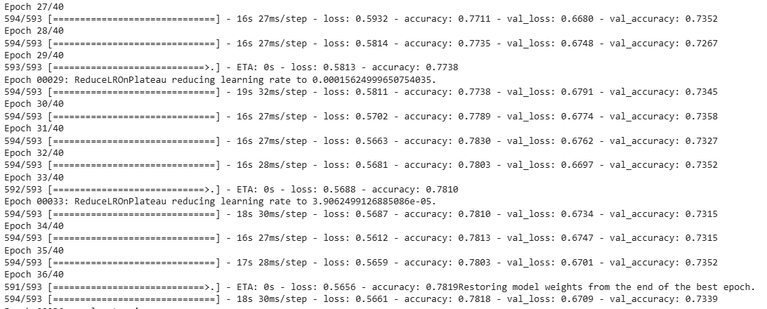
TRAINING

Slide 11
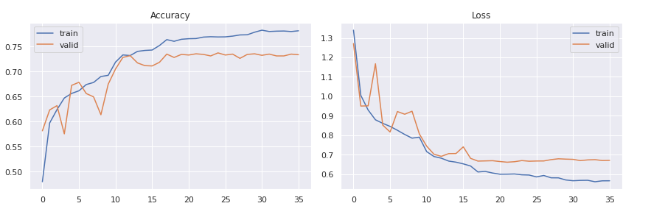
Accuracy & loss

Slide 12
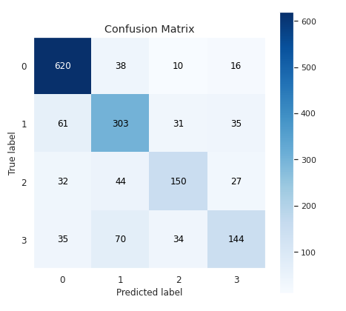
Confusion matrix

Slide 13
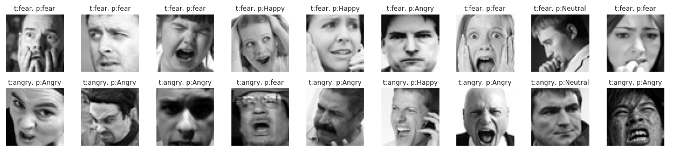
Predicted images

Slide 14





Thank You

